Slide 1
Alaska Career Guide Demonstration Project
State Board of Education
Alaska Department of Education and Early Development
Dr. Monica Goyette, Director
Brad Billings, Career and Technical Education Administrator
Zach Stanson, DEED Contracted Project Coordinator
March 10, 2026

Slide 2
Mission, Vision, and Purpose
Mission | Vision | Purpose
An excellent education for every student every day. | All students will succeed in their education and work, shape worthwhile and satisfying lives for themselves, exemplify the best values of society, and be effective in improving the character and quality of the world about them. - Alaska Statute 14.03.015 | DEED exists to provide information, resources, and leadership to support an excellent education for every student every day.

Slide 3

Alaska’s Education Challenge
Five Shared Strategic Priorities:
Support all students to read at grade level by the end of
third grade.
Increase career, technical, and culturally relevant education
to meet student and workforce needs.
Close the achievement gap by ensuring equitable educational
rigor and resources.
Prepare, attract, and retain effective education professionals.
Improve the safety and well-being of students through school partnerships with families, communities, and tribes.

Slide 4
Agenda
The Alaska Career Guide Model
Core Components of the RootEd Model
Leveraging Existing State Resources
Career Guide Staffing Model
Alaska Career Guide Partners
FY2025 Year 1 Survey Results
FAFSA Completion: National Context and Alaska Impact
2025 rootEd AK Students by Pathway
  Postsecondary Choices and Workforce Alignment
  Top College Majors
  Top Career Training Programs
  Barriers to Pathway Selection
Opportunities for Growth
Pilot Expansion: FY2026 Participants & FY2027 Potential Participants

Slide 5
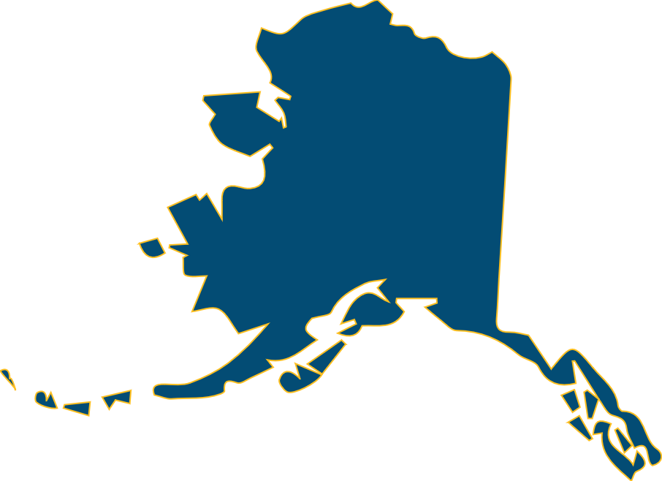
Alaska Workforce Opportunity: Importing Labor, Exporting Wealth
23%
34,000
Of Alaska workers
are non-residents
Decline in prime working age population since 2013
$3.8
Billion in wages leaves the state annually
(17% of every dollar earned)
Schultz, G. (2026). Nonresidents working in Alaska: 2024. Alaska Department of Labor and Workforce Development, Research and Analysis Section.

Slide 6

The Alaska Career Guide Model
The Alaska Career Guide model ensures that every participating senior graduates with a clear, actionable postsecondary plan.
Partnered with rootEd Alliance, a philanthropic organization focused on supporting rural high school seniors. Alaska was the fifth state to join the alliance.

Slide 7




The Alaska Career Guide Model
The model is a structured advising framework designed to ensure every
senior transitions from high school into a defined postsecondary pathway.
workforce
Military
Career training &
apprenticeships
2 YR
4 YR
Two-year college
four-year college

Slide 8




Core Components of the RootEd Model
Structured Senior Advising Cycle
Postsecondary Application Support
Minimum of two one-on-one meetings throughout
the senior year.
Hands on support for college, training, apprenticeship, military, and job applications.
Dedicated Career Guides
Each senior is supported by a trained guide and team working together
to track progress and ensure a clear plan.
Financial Aid Navigation
Career Exposure
Connections to employers, training providers, and regional opportunities.
FAFSA* completion, Alaska Performance Scholarship, and scholarship guidance.
*Free Application for Federal Student Aid - FAFSA

Slide 9
Career Guide Project Coordination
DEED Contracted Project Coordinator
The Department provides centralized coordination to ensure strong implementation and long-term scalability of the Alaska Career Guide Model.
  Implementation
  & Fidelity
  Training
  & Support
  Monitoring &
  Continuous Improvement
  Outreach
  & Expansion
    Ensure implementation fidelity to the rootEd advising model
    Serve as liaison with rootEd Alliance and all Alaska partners
    Provide mentoring and training for new Career Guides
    Coordinate monthly professional development sessions
    Lead planning and execution of the annual statewide convening
    Ongoing progress monitoring across participating districts
    Development of reporting tools, data summaries, and presentation materials
    Support expansion
    into additional districts
    Lead project outreach and stakeholder engagement

Slide 10



Leveraging Existing State Resources
The Career Guide model aligns and activates existing state systems to support senior transition planning. This model ensures students actively use state resources during senior year rather than encountering them after graduation.
  Department of Labor and Workforce Development
  Monthly student Lunch & Learn sessions highlighting postsecondary & workforce pathways
  AlaskaJobs system for resume development, interview preparation, and job search
  Continued access to employment tools after graduation
  Alaska Commission on Postsecondary Education
  Alaska Career Information System (AKCIS) career exploration platform
  Alaska Performance Scholarship guidance
  Free Application for Federal Student Aid (FAFSA) completion support and financial aid navigation
  Department of Education and Early Development
  Connecting existing K-12 Career and Technical Education (CTE) programs to post-secondary opportunities
  Statewide professional development support
  Data tracking and Key Performance Indicator (KPI) monitoring
  Dedicated CTE funding to support implementation of the model

Slide 11



Who Can Serve as a Career Guide
The model is flexible and locally driven. Career Guides may be:
CTE
School district
School district career & technical education consortium
Certificated/Non-Certificated
Certificated/Non-Certificated
Partner organization
State agency
Tribal Entity
Department of Labor & Workforce Development
Districts determine the staffing model. DEED provides the structure and support.

Slide 12
Alaska Career Guide Partners FY2026
8
20
208
School Districts
Schools
Seniors
Bristol Bay Regional Career and Technical Consortium (BBRCTE)
Bristol Bay Borough School District
Dillingham City Schools
Lake and Peninsula School District
Southwest Region School District
Department of Labor and Workforce Development (DOLWD)
  Galena City School District
  Nenana City School District
Sealaska Heritage Institute (SHI)
  Annette Island City Schools
  Hydaburg City Schools

Slide 13
FY2025 Year 1 Survey Results
Overall satisfaction across stakeholders was strong in Year 1 implementation:
of participating students reported being satisfied with their Career Guide.
of Career Guides reported feeling valued and supported within the model.
of administrators/counselors reported satisfaction with the Career Guide’s work.
  These results indicate strong acceptance of the model at the student, advisor,
  and school leadership levels during the first year of implementation.
85%
100%
94%

Slide 14

Free Application for Federal Student Aid (FAFSA)
The FAFSA is the required application for federal financial aid, state financial aid (including the Alaska Performance Scholarship), and most institutional aid. Completion is a critical early milestone in postsecondary planning.
FASFA COMPLETION RATE
National Context
45-55%¹
Alaska Statewide | Class of 2025
29.1%
Career Guide Year 1 | FY2025
41.4%
+12%
Increase compared
to the statewide rate.
¹ National College Attainment Network, FAFSA Completion Rates – Class of 2025 (2024).

Slide 15
2025 rootEd AK Students by Pathway
Still Deciding
4-Year College
25%
28%
Workforce w/o Training
8%
13%
2-Year College
3%
Military
Career Training
23%
67% of rootEd Alaska students are planning to
pursue further training (college, career training, or military).

Slide 16





2025 rootEd AK Students by Pathway
Top 5 College majors (2- and 4- Year)
27%
Health Professions
28%
12%
Engineering
13%
8%
Social Sciences
4%
Business
4%
Education

Slide 17




2025 rootEd AK Students by Pathway
Career Training programs
13%
Lineman
13%
Mechanic
7%
Electrician
23%
7%
Health Care
4%
Welding

Slide 18




Barriers to Pathway Selection
Still deciding
50%
Waiting to see what happens
50%
Overwhelmed by choices
?
38%
Unsure of interests
25%
19%
Concerned about cost
19%
Not sure about options

Slide 19




Opportunities for Growth
Strengthen Support for Workforce-Bound Students
Advisors need more tools and strategies to guide students entering the workforce directly - especially to help connect them with living-wage career opportunities.
Expand Resources for Still Deciding Students
There is a clear need for targeted advising and materials to help undecided students explore viable postsecondary options and make informed decisions.
Deepen Impact of Career Exposure Opportunities
Advisors need additional support to deepen and expand the impact of Career Exposure offerings, increase awareness of best practices across regions, and receive guidance on partnership development.
Improve Communications with Stakeholders
Feedback from administrators highlights an opportunity to strengthen how the program’s goals, successes, and supports are communicated to both internal and external audiences.

Slide 20
Pilot Expansion | FY26 Participants & FY27 Potential Participants
FY2026 Participants
  Annette Island City
  Bristol Bay
  Dillingham City
  Galena City
  Hydaburg City
  Lake and Peninsula
  Nenana City
  Southwest Region
FY2027 Potential Participants
  Alaska Gateway
  Chatham
  Copper River
  Delta/Greely
  Haines Borough
  Hoonah City
  Juneau
  Kake City
  Ketchikan Gateway
  Klawock City
  Mt. Edgecumbe High School
  Pelican City
  Petersburg
  Sitka
  Skagway
  Southeast Island – Starting Spring 2026
  Wrangell
  Yakutat
The model is
designed for scalability.

Slide 21

Board Questions or Comments

Slide 22
Contact Information
Monica Goyette, Director
monica.goyette@alaska.gov
Brad Billings, Career and Technical Education Administrator
brad.billings@alaska.gov
Zach Stanson, DEED Contracted Project Coordinator
zach@pathfinderak.com

Slide 23
Stay Connected
Find us online:
Our website: education.alaska.gov
Facebook and Twitter: @AlaskaDEED
Give us a ring:
Main line: 907 465 2800
Teacher Certification: 907 465 2831

